Slide 1
专业外语
软件工程 物联网
2023-1-2

Slide 2
PART 1 COMPUTER ARCHITETURE AND COMPUTER NETWORK CHAPTER 1 COMPUTER ORGANIZATION AND UNITS

Slide 3
1.3 Memory

Slide 4
KEYWORDS
RAM（random-access memory） 随机存储器
ROM（read-only memory） 只读存储器
CMOS（Complementary Metal-Oxide Semiconductor）
互补金属氧化物半导体
volatile 易失性
DRAM（Dynamic RAM） 动态随机存储器
SRAM（Static RAM） 静态随机存储器
cache 高速缓冲存储器
flash memory 快闪存储器，闪存

Slide 5
1. Memory System Desiderata
The memory system has three desiderata.
(1) Size: infinitely large, no constraints on program or data set size.
(2) Speed: infinitely fast, latency equal to the fastest memory technology available.
(3) Cost: per bit cost should approach the lowest-cost technology available.
Clearly these specifications cannot all be achieved as they are mutually exclusive. However, with the semiconductor and magnetic memory technology of today, these specifications are closely approximated.

Slide 6
2. Memory
Memory is a holding area for data, instructions, and information.
Like microprocessors, memory is contained on chips connected to the system board.
There are three well-know types of memory chips: random-access memory (RAM), read-only memory (ROM), and complementary metal-oxide semiconductor (CMOS).

Slide 7
(1) RAM
Random-access memory (RAM) chips hold the program (sequence of instructions) and data that the CPU is presently processing.
Before data can be processed or a program can be run, it must be in RAM.
For this reason, RAM is sometimes referred to as primary storage.
RAM is called temporary or volatile storage because everything in most types of RAM is lost as soon as the microcomputer is turned off.
It is also lost if there is a power failure or other disruption of the electric current going to the microcomputer.

Slide 8
There are two types of RAM: Dynamic RAM (DRAM) and Static RAM (SRAM).
① DRAM
Recent advances in DRAM chips have produced three types of DRAM chips:
* Synchronous DRAM (SDRAM) is faster than conventional RAM chips and more expensive.
SDRAM chips streamline operations by coordinating or synchronizing the movement of data and instructions between the chip and other components in the system unit.

Slide 9
Double data rate SDRAM (DDR SDRAM), also known as SDRAM II, is faster, more reliable, and more expensive than SDRAM.
DDR SDRAM chips are able to transfer twice (double) as much data in the same amount of times as SDRAM.
* Direct DRAM is the fastest and most expensive.
Almost all of today’s microcomputers use a combination of DRAM chips.

Slide 10
② SRAM
Static RAM (SRAM), like DRAM, requires a constant supply of power.
Compared to DRAM, SRAM does not require as much power, is faster, and is more reliable.
SRAM is also more expensive and typically used for specialized applications.
One of these applications is for cache memory or RAM cache.

Slide 11
③ CACHE
Cache (pronounced “cash”) memory improves processing by acting as a temporary high-speed holding area between the memory and the CPU.
In a computer with a cache (not all machines have one), the computer detects which information in RAM is most frequently used.
It then copies that information into the cache.
When needed, the CPU can quickly access the information from the cache.

Slide 12
There are three different types or levels of cache:
* Level 1 (L1), also known as primary cache and internal cache, is built into the microprocessor chip.
* Level 2 (L2), also known as external cache, is slower than L1 but has a greater capacity.
In older computers with older microprocessors, the Level 2 cache is located on a chip that is plugged into the system board.
New computers with newer microprocessors have the L2 caches built into the microprocessor.
This arrangement, sometimes referred to as advanced transfer cache, provides faster response than cache located on the system board.

Slide 13
* Level 3 (L3), the newest type of cache, works with special microprocessor L2 caches.
L3 caches are not built into the microprocessor.
Rather, L3 caches use SDRAM chips located on the system board.
Most of today’s microcomputers have two or three types of cache.
The most powerful have all three types.

Slide 14
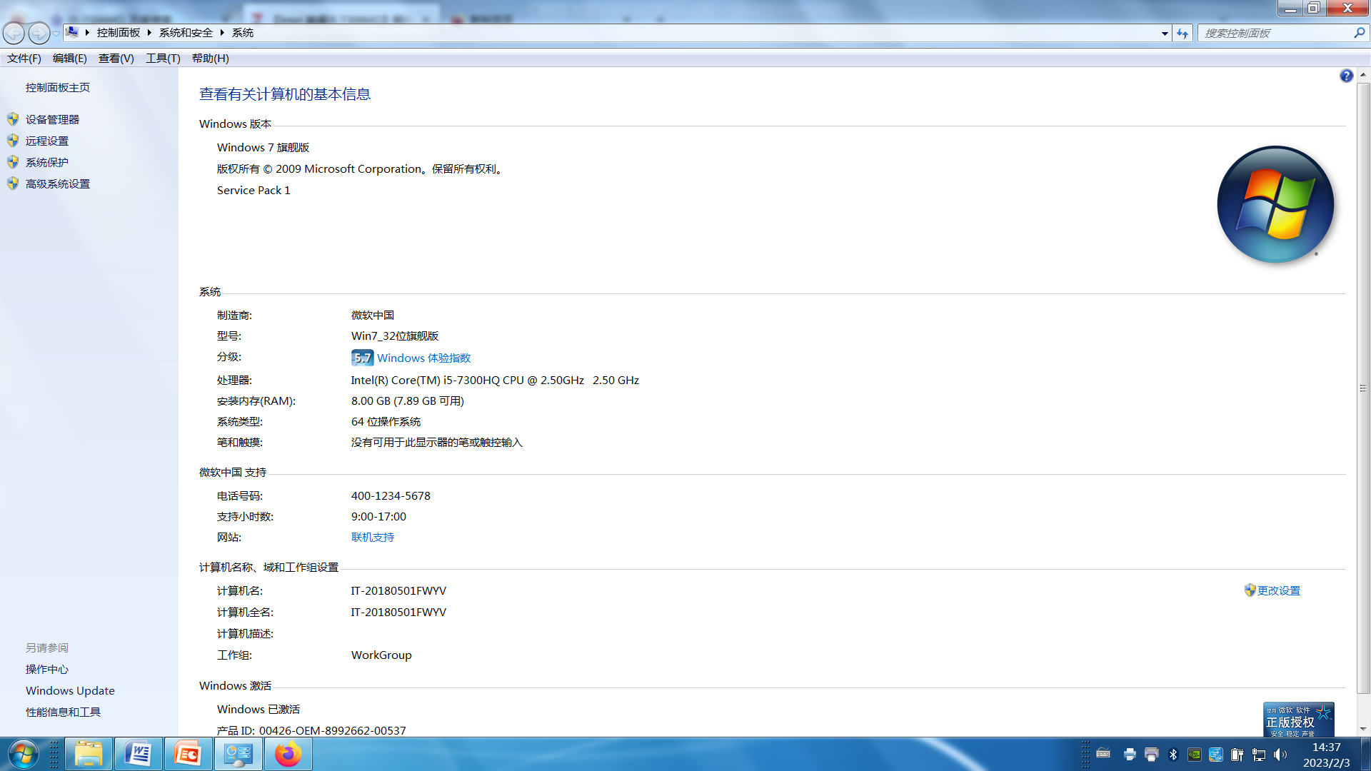
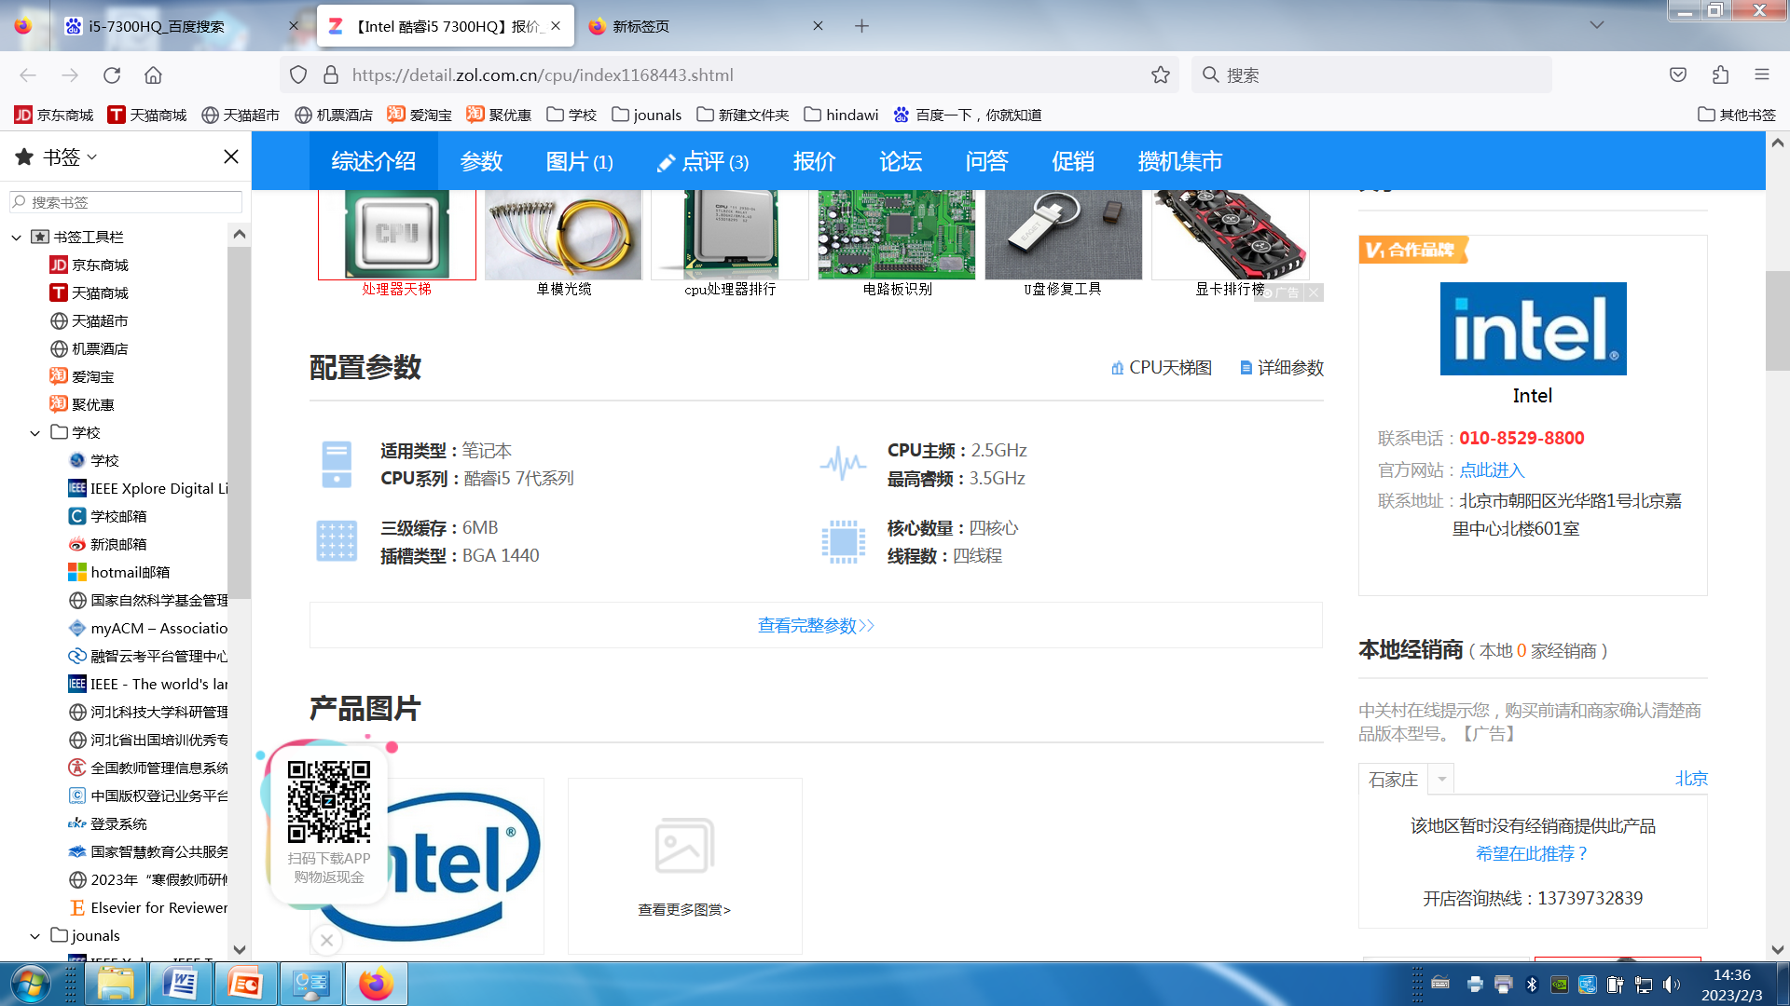

Slide 15
④ FLASH RAM
Flash RAM or flash memory chips can retain data even if power is disrupted.
This type of RAM is the most expensive and used primarily for special applications such as for digital cell telephones, digital video cameras, and portable computers.

Slide 16
(2) ROM
Read-only memory (ROM) chips have programs built into them at the factory.
Unlike RAM chips, ROM chips are not volatile and cannot be changed by the user.
“Read only” means that the CPU can read or retrieve data and programs written on the ROM chip.
However, the computer cannot write—encode or change—the information or instructions in ROM.

Slide 17
ROM chips typically contain special instructions for detailed computer operations.
For example, ROM instructions are needed to start a computer, give keyboard keys their special control capabilities, and put characters on the screen.

Slide 18
(3) CMOS
A complementary metal—oxide semiconductor (CMOS) chip provides flexibility and expandability for a computer system.
It contains essential information that is required every time the computer system is turned on.
The chip supplies such information as the current date and time, amount of RAM, type of keyboard, mouse, monitor, and disk drives.

Slide 19
Unlike RAM, it is powered by a battery and does not lose its contents when the power is turned off.
Unlike ROM, its contents can be changed to reflect changes in the computer system such as increased RAM and new hardware devices.

Slide 20
1.4 SECONDARY STORAGES

Slide 21
KEYWORDS
external storage 外部存储器
storage capacity 存储容量
floppy disk drive 软（磁）盘驱动器
storage medium 存储媒体
hard disk 硬（磁）盘
hard-disk cartridge 盒式硬盘
hard-disk pack 硬盘组
cassette 盒，磁带盒

Slide 22
videocassette recorder 盒式录像机
disk cache 磁盘高速缓存
RAID (Redundant Arrays of Independent Disks)
独立磁盘冗余阵列
file compression 文件压缩
file decompression 文件解压缩
optical disc 光盘
GB (gigabytes) 吉字节
compact disc 高密度磁盘，光盘

Slide 23
CD-ROM（Compact Disc-Read-Only-Memory）
光盘只读存储器
CD-R（CD-recordable） 可录制光盘
CD-RW（Compact Disc Rewritable） 可重写光盘
DVD（Digital Versatile Disc，Digital Video Disc）
数字通用光盘，数字视频光盘
high-definition discs 高清晰光盘
hi def（high definition） 高清晰度，高分辨率

Slide 24
solid-state storage
固态存储器，半导体存储器
magnetic type 磁带
read/write head 读／写磁头
flash memory card 闪存卡
USB drive U 盘驱动器

Slide 25
As most RAM provides only temporary or volatile storage, therefore we need more permanent or nonvolatile storage for data and programs.
We also need external storage because users need much more storage capacity than which is typically available in a computer’s primary or RAM memory.

Slide 26
Secondary storage provides permanent or nonvolatile storage.
Using secondary storage devices such as a hard disk drive, data and programs can be retained after the computer has been shut off.
This is accomplished by writing files to and reading files from secondary storage devices.

Slide 27
1. HARD DISKS
Compared to floppy disks, hard disks are able to store and retrieve information much faster and have a greater capacity.
There are three types of hard disks:
① Internal hard disk, an internal hard disk is located inside the system unit.
② Hard-disk cartridges, are as easy to remove as a cassette from a videocassette recorder.

Slide 28
③ Hard-disk packs
Hard-disk packs, are removable storage devices used to store massive amounts of information.
Their capacity far exceeds the other types of hard disks.
Three ways to improve the performance of hard disks are disk caching, redundant arrays of inexpensive disks (RAID), and file compression/decompression

Slide 29
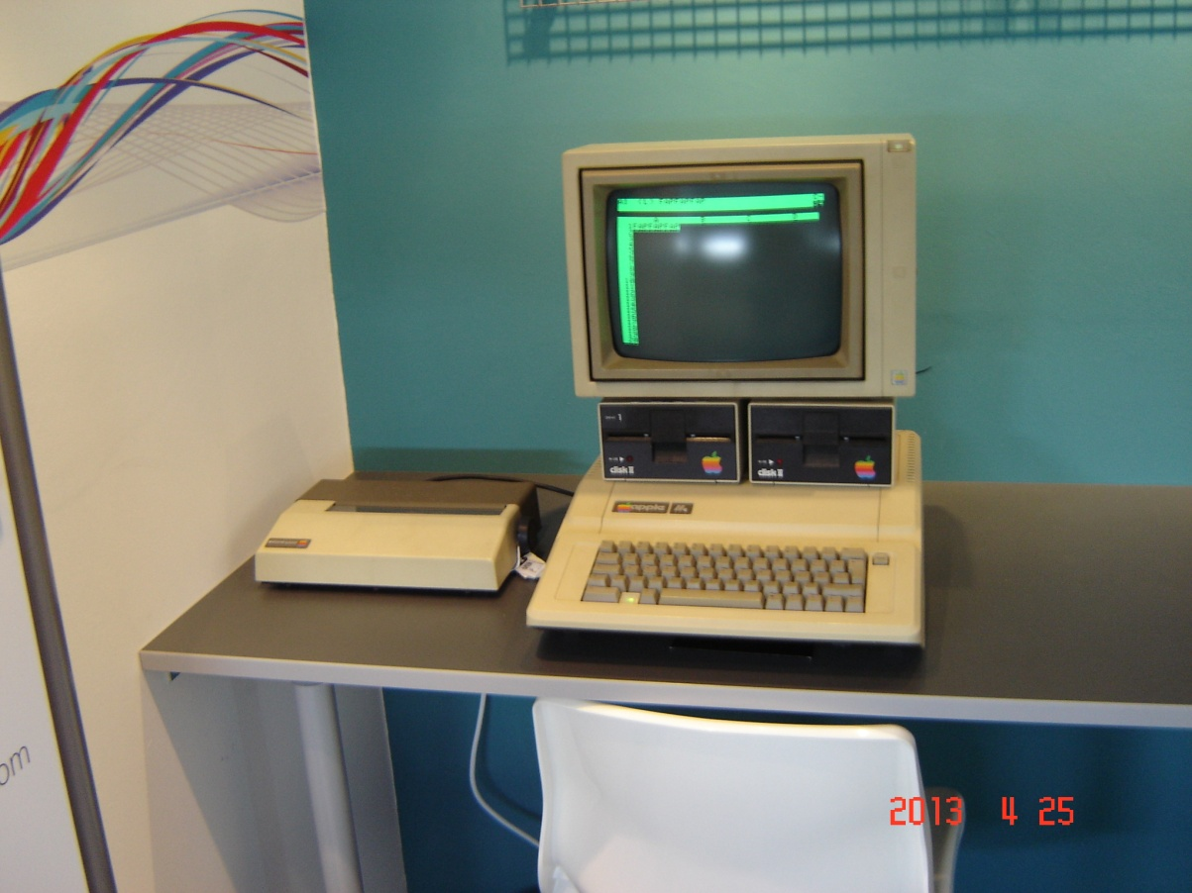
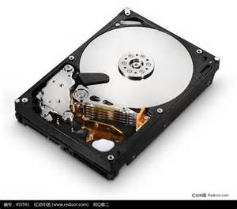

Slide 30
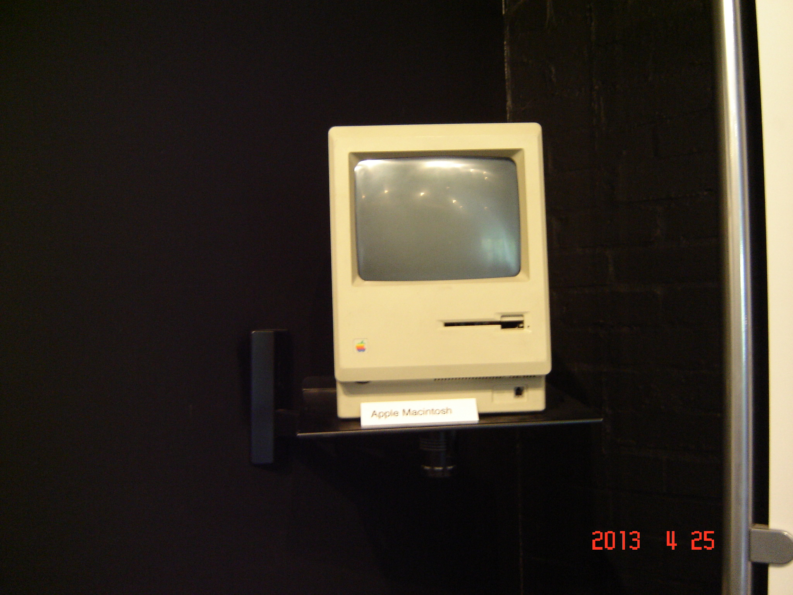

Slide 31
2. OPTICAL DISCS
Today’s optical discs can hold over 50 gigabytes of data.
That is the equivalent of millions of typewritten pages or a medium-sized library all on a single disc.
(1) Compact disc
Compact disc, or as it is better known, CD, is one of the most widely used optical formats.

Slide 32
There are three basic types of CDs: read only, write once, and rewritable:
① Read only-CD-ROM, which stands for compact disc-read-only memory, is similar to a commercial music CD. Read only means it cannot be written on or erased by the user.
② Write once-CD-R, which stands for CD-recordable, can be written to once. After that they can be read many times without deterioration but cannot be written on or erased.
③Rewriteable-CD-RW stands for compact disc rewritable. Also known as erasable optical discs.

Slide 33
(2) Digital versatile disc (DVD)
DVD stands for digital versatile disc or digital video disc.
This is a newer format that has replaced CDs as the standard optical disc.

Slide 34
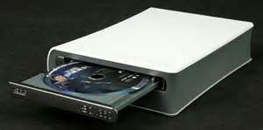
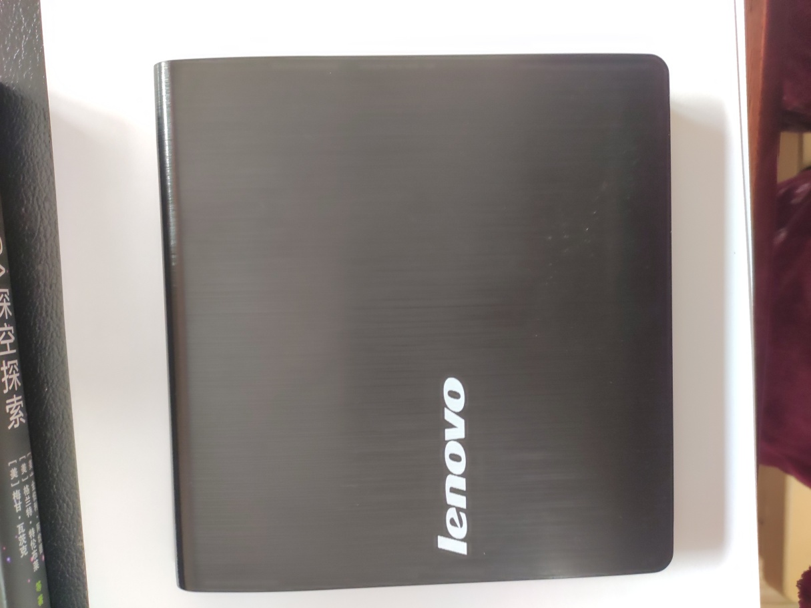
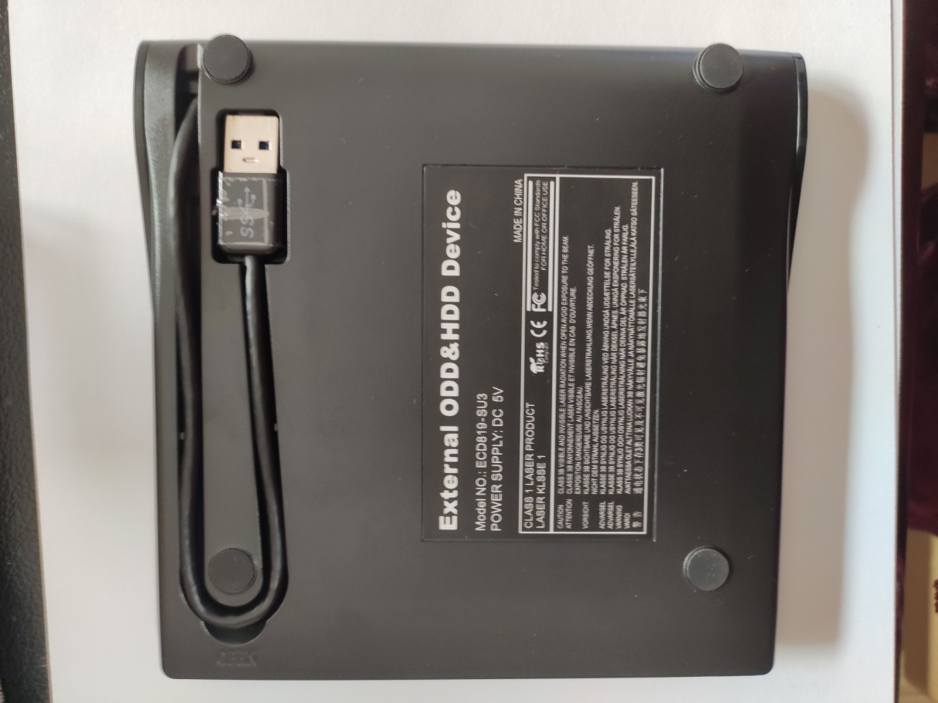

Slide 35
(3) High-definition disc
High-definition disc is the next generation of optical disc and is called as hi def (high definition), with a far greater capacity than DVDs.
Like CDs and DVDs, hi def has three basic types: read only, write once, and rewriteable.

Slide 36
3. Other types of secondary storage
(1) Solid-state storage
Each of the secondary storage devices discussed thus far has moving parts.
For example, hard disks rotate and read/write heads move in and out.
Unlike these devices, solid-state storage devices have no moving parts.
Data and information are stored and retrieved electronically directly from these devices much as they would be from conventional computer memory.

Slide 37
① Flash memory cards are credit card-sized solid-state storage devices widely used in notebook computers.
② USB drives, also known as USB flash drives, are so compact that they can be transported on a key ring or a necklace. These drives conveniently connect directly to a computer’s USB port to transfer files.

Slide 38
(2) Internet hard drives
Special service sites on the Web provide users with storage.
This storage is called an Internet hard drive (See Figure 1-11).

Slide 39
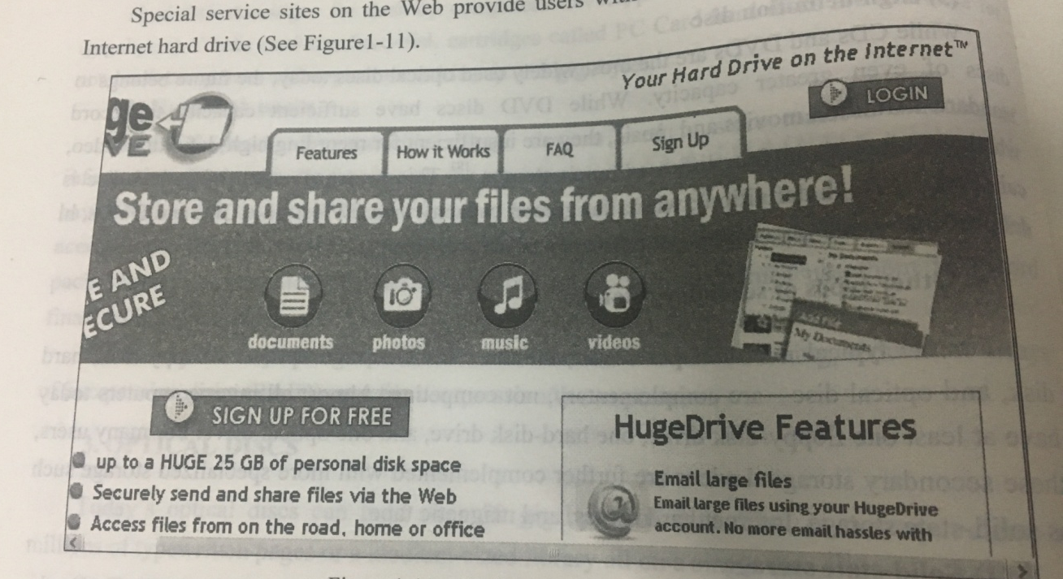
Figure 1-11 An Internet hard drive site

Slide 40
Advantages of Internet hard drives compared to other types of secondary storage include low cost and the flexibility to access information from any location using the Internet.

Slide 41
(3) Magnetic tape
Magnetic tape is a slower sequential access device.
Although slower to access specific information, magnetic tape is an effective and commonly used tool for backing up data.

Slide 42
1.5 INPUT AND OUTPUT DEVICES

Slide 43
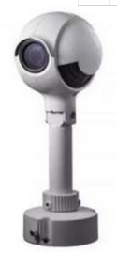
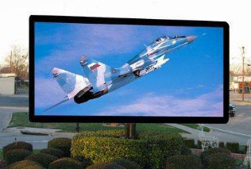
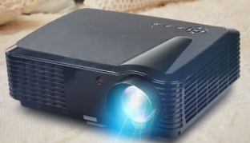
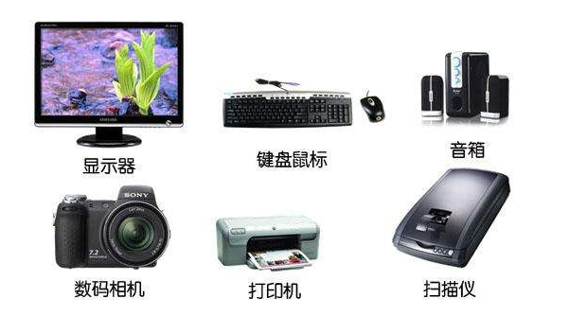
摄像头
投影仪
LED显示屏

Slide 44
KEYWORDS
hard copy 硬拷贝
soft copy 软拷贝
pointing 定位，定点，指向
pointer 指针
joystick 操作杆
touch screen 触摸屏
light pen 光笔

Slide 45
stylus 记录笔
mechanical mouse 机械鼠标
optical mouse 光学鼠标
cordless (wireless) mouse 无线鼠标
scanner 扫描仪
optical scanner 光学扫描仪
bar code reader 条形码阅读器
image capturing 图像捕获
audio-input 音频输入

Slide 46
1. Input Devices
(1) Keyboard Entry
One of the most common ways to input data is by keyboard.
There are a wide variety of different keyboard designs. They range from the full-sized to miniature and from rigid to flexible.

Slide 47
Most common types are :
* Traditional Keyboards (Figure 1-12)
* Flexible Keyboards (Figure 1-13)
* Ergonomic Keyboards (Figure 1-14)
* Wireless keyboards
* PDA keyboards

Slide 48
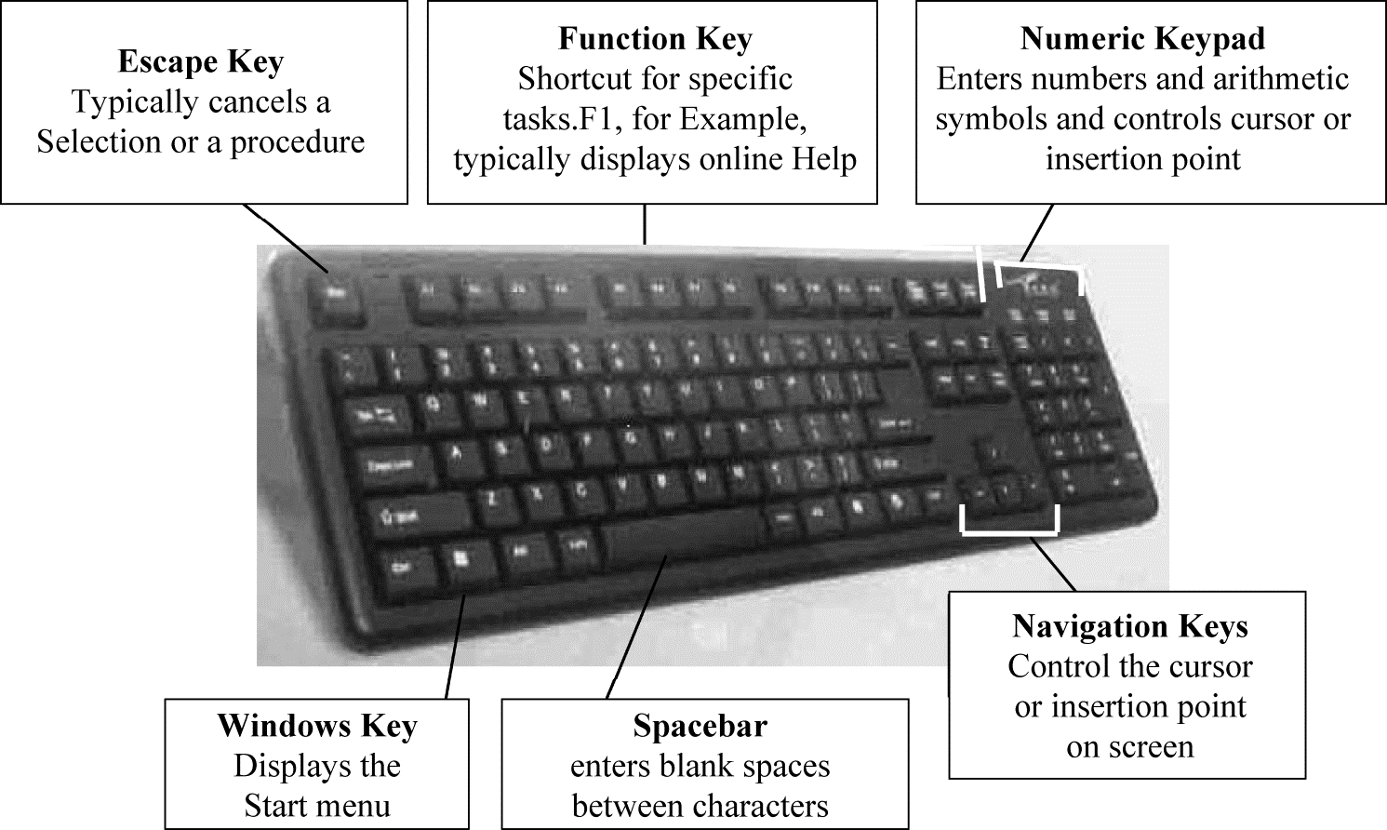
Figure 1-12 Traditional keyboard

Slide 49
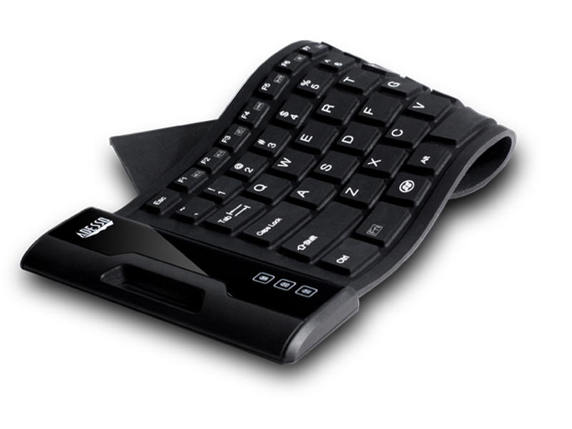
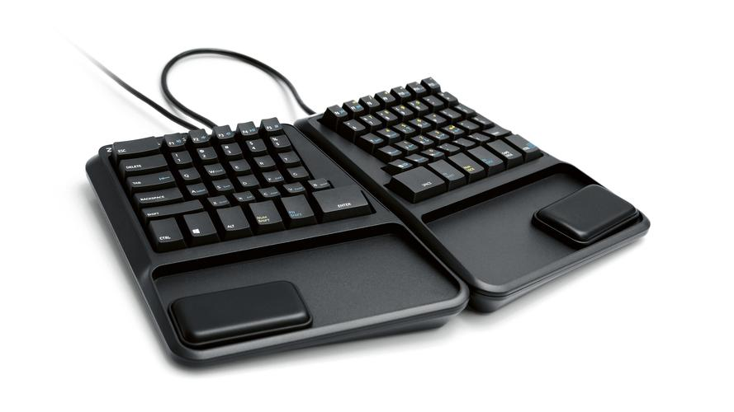
From the Internet
Figure 1-13 Flexible keyboard
Figure 1-14 Ergonomic keyboard

Slide 50
(2) Pointing Devices
① Mice
A mouse controls a pointer that is displayed on the monitor.
The mouse pointer usually appears in the shape of an arrow.
Although there are several different mouse types, there are three basic designs: Mechanical mouse, Optical mouse, Cordless or wireless mouse.

Slide 51
② Joysticks
A joystick is the most popular input device for computer games. (See Figure 1-15).

Slide 52
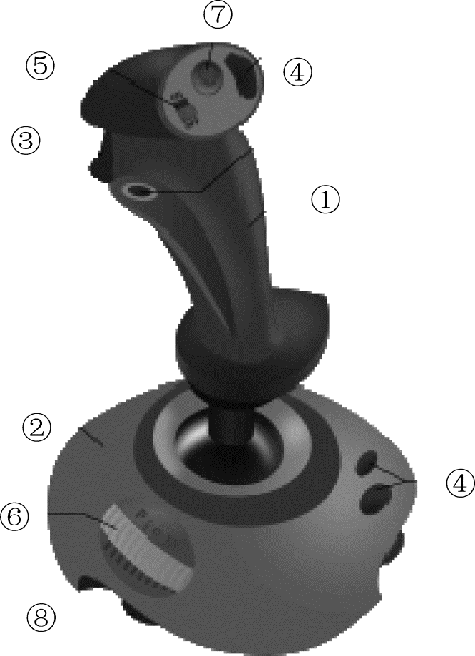
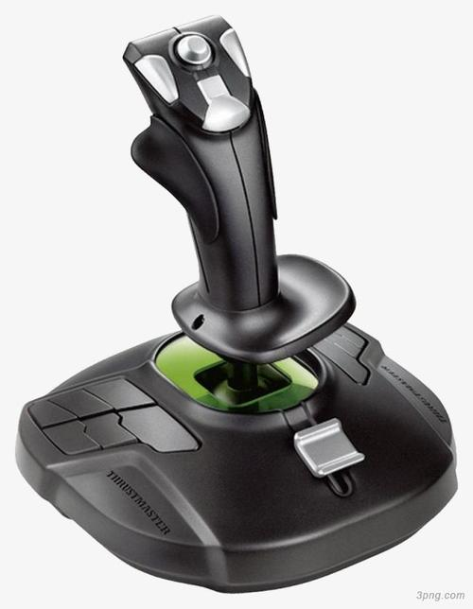
Figure 1-15 Video game joystick elements: 1. stick, 2. base, 3. trigger, 4. extra buttons, 5. autofire switch, 6. throttle, 7. hat switch (POV hat), 8. suction cup
From the Internet

Slide 53
③ Touch Screen
A touch screen is a particular kind of monitor and is commonly used at restaurants, automated teller machines (ATMs), and information centers. (See Figure 1-16.)

Slide 54
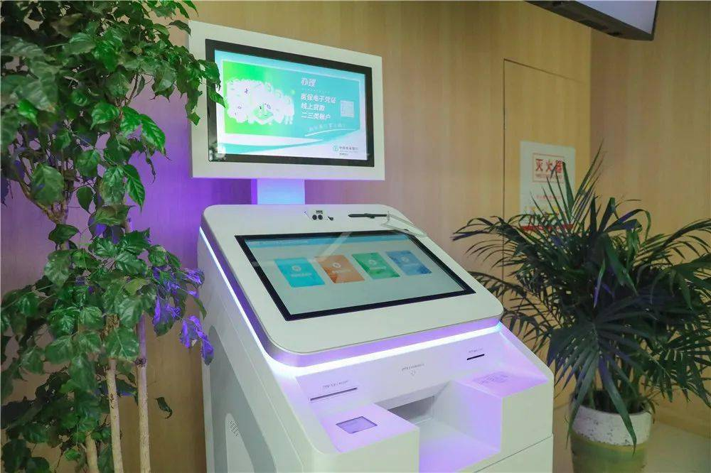
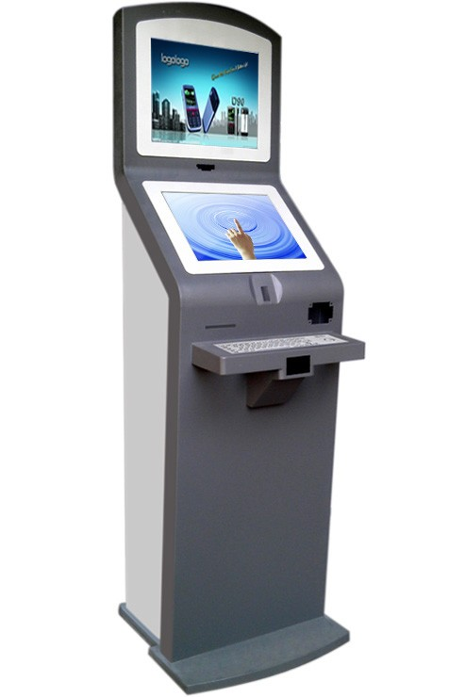
From the Internet
Figure 1-16 A touch screen: a consumer application

Slide 55
④ Light Pen
A light pen is a light-sensitive penlike device.
The light pen is placed against the monitor.
This closes a photoelectric circuit and identifies the spot for entering or modifying data.
For example, light pens are used to edit digital images and drawings.

Slide 56
⑤ Stylus
A stylus is a penlike device commonly used with tablet PCs and PDAs. (See Figure 1-17.)
A stylus uses pressure to draw images on a screen.
A stylus interacts with the computer through handwriting recognition software.
Handwriting recognition software translates handwritten notes into a form that the system unit can process.

Slide 57
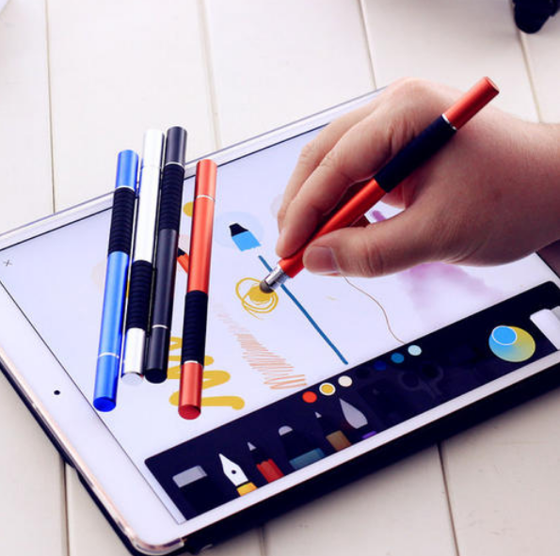
From the Internet
Figure 1-17 Stylus

Slide 58
(3) Scanning Devices
Scanners move across text and images. Scanning devices convert scanned text and images into a form that the system unit can process.
There are four types of scanning devices: optical scanners, card readers, bar code readers and character and mark recognition devices.

Slide 59
(4) Image Capturing Devices
Like traditional copy machines, image capturing devices are optical scanners that can make a copy from an original.
(5) Audio-Input devices
Audio-input devices convert sounds into a form that can be processed by the system unit.
By far the most widely used audio-input device is the microphone.

Slide 60
2. Output Devices
(1) Monitors
The most frequently used output device is the monitor.
Also known as display screens, monitors present visual images of text and graphics.
The output is often referred to as soft copy.

Slide 61
(2) Printers
You probably use a printer with some frequency to print homework assignments, photographs, and Web pages.
Printers translate information that has been processed by the system unit and present the information on paper.
Printer output is often called hard copy.

Slide 62
3. Combination Input and Output Devices
Many devices combine input and output capabilities.
Sometimes this is done to save space.
Other times it is done for very specialized applications.
Common combination devices include fax machines, multifunctional devices, Internet telephones, and terminals.

Slide 63
The End of this Section

